Slide 1
The Little Green Web App
A website by:
Jonas M. Olsson, John Harrow and Jack Wier

Slide 2
The Applications of the Website
Information about eco-friendly living, map, recipes and a quiz for fun
Mixes fun, information and a map
Targeted at young people
People that moved recently

Slide 3
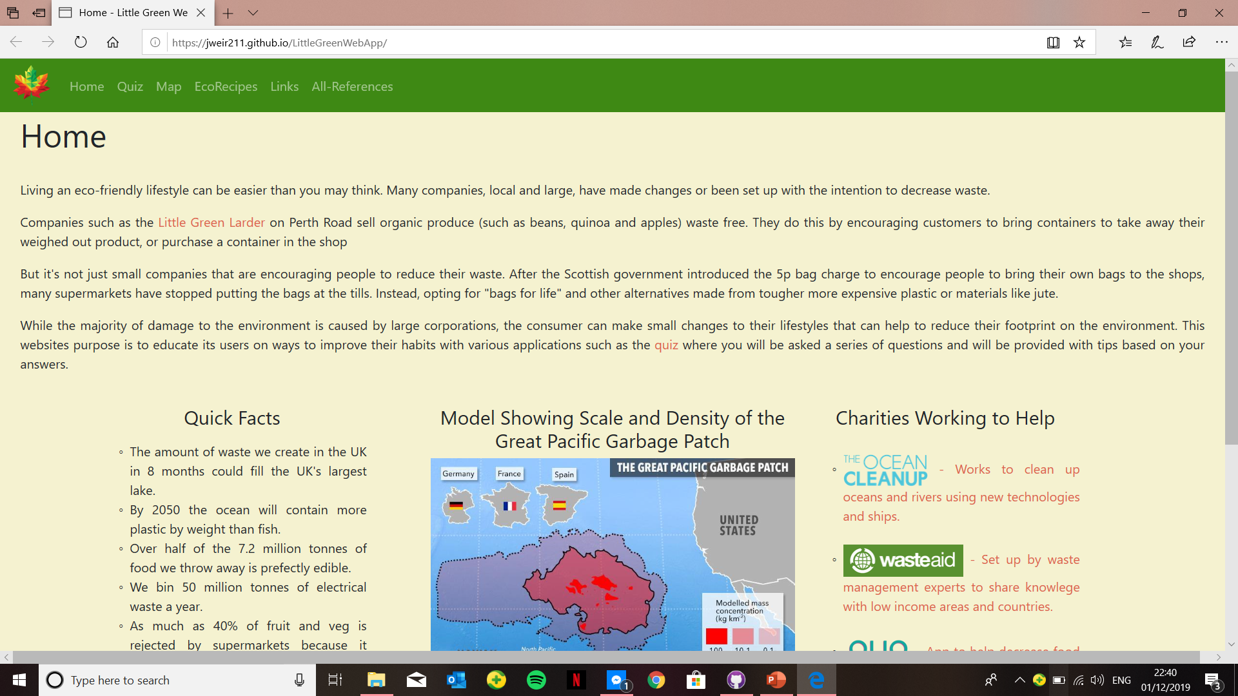
The Home-page
The purpose of our home page is to explain the functions of the site.
It also provides some facts about waste and the environment.
It provides links to websites and charities

Slide 4
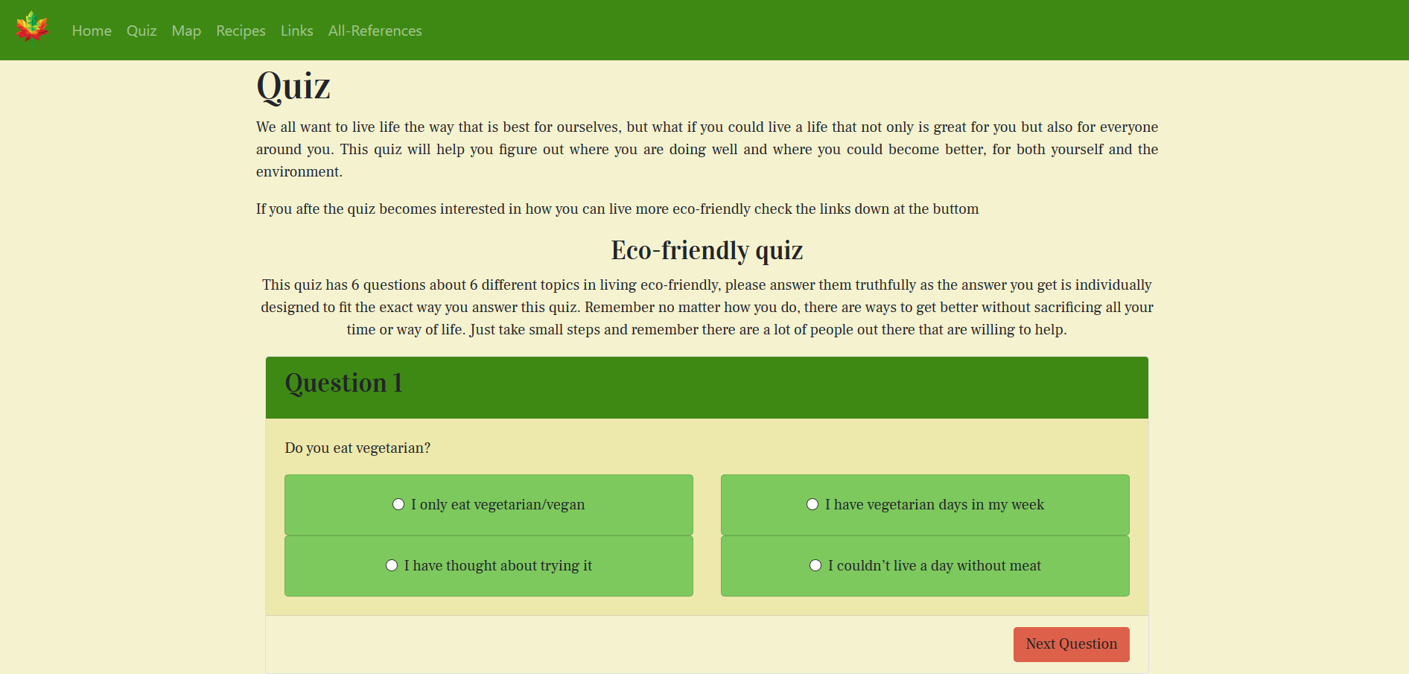
The quiz
The quiz asks 6 questions, from 6 different topics in eco-friendly living
The quiz gives individual responses depending on what you answered in each question
Links to other advice pages

Slide 5
Map

Slide 6
Recipes

Slide 7
Now a live presentation
“https://jweir211.github.io/LittleGreenWebApp”

Slide 8
Why our application is needed
Mixes fun and information
Nice down on earth website to give advice without judgement

